Slide 1
Exploration of Seizure Prediction Methods Tailored for Wearable Devices
Integrated Systems Laboratory (ETH Zürich)
Kyrill Toulev toulevk@student.ethz.ch
Supervisors:
Thorir Ingolfsson
Dr. Victor Kartsch
Dr. Andrea Cossettini
Professor: Prof. Dr. Luca Benini

Slide 2
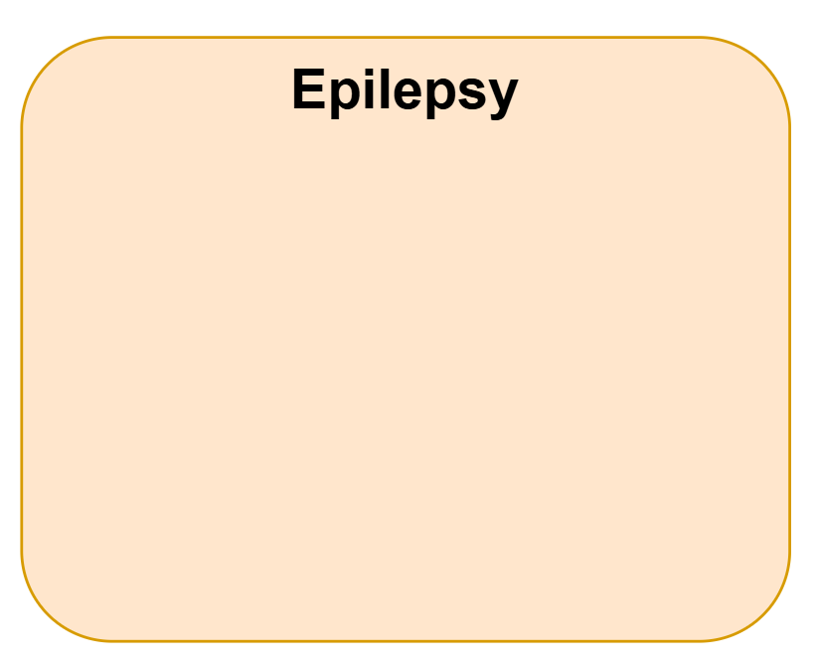
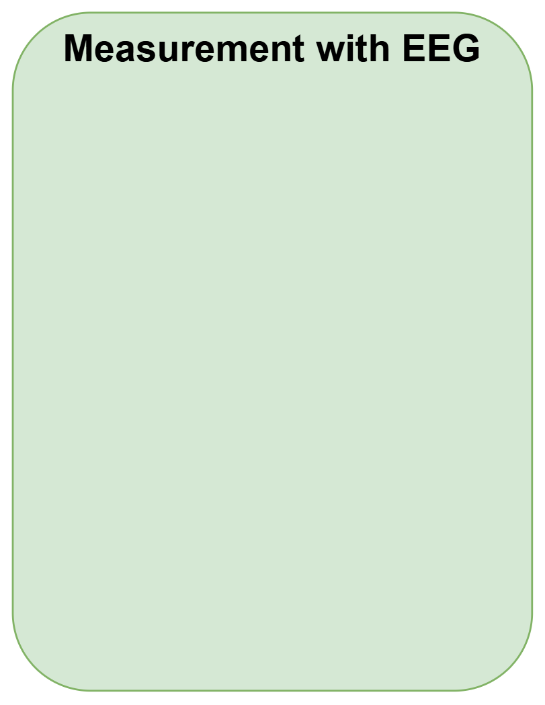
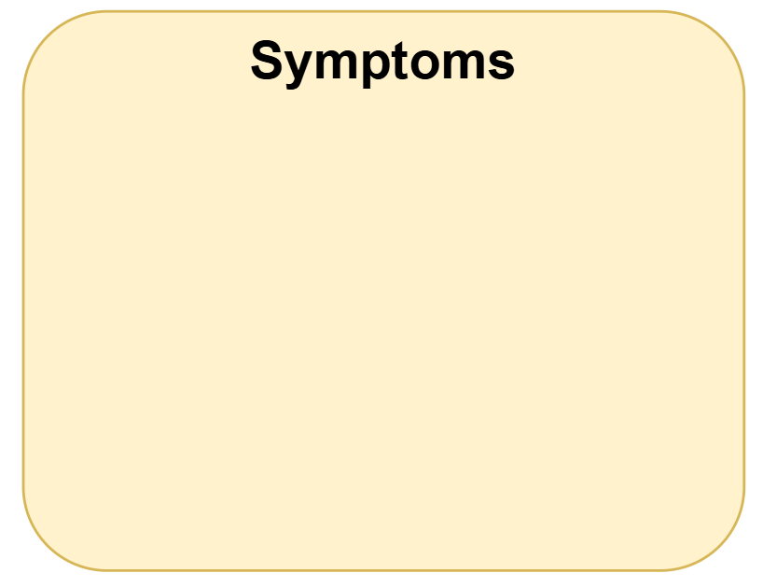

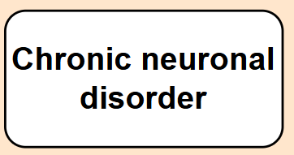
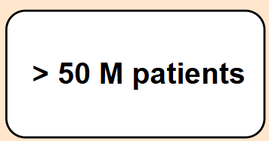

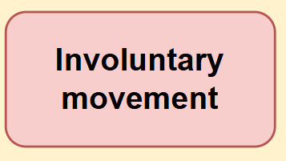
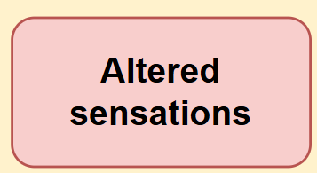
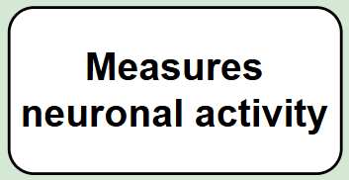
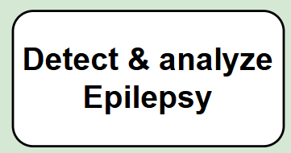
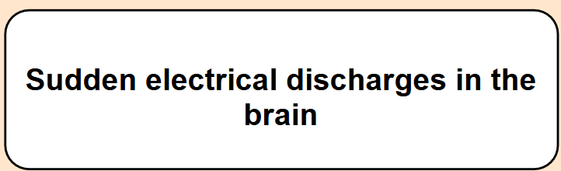
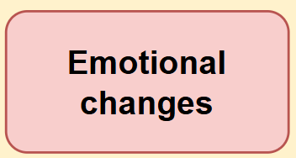
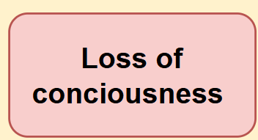
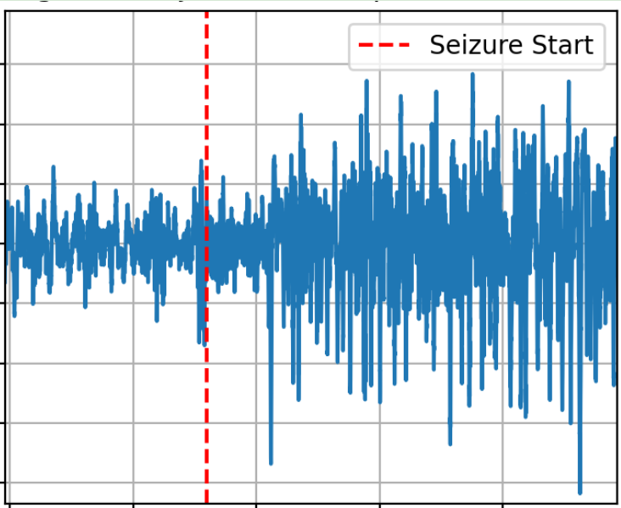
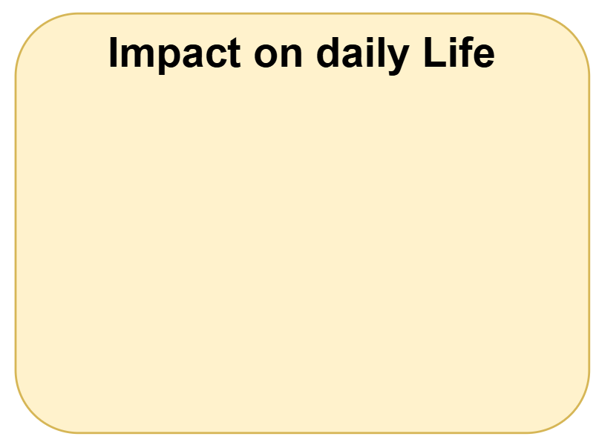



Epileptic Seizures
Most Works:
Detection of Seizures, not Prediction
Predict Seizures in Advance
Patient are Prepared

Slide 3
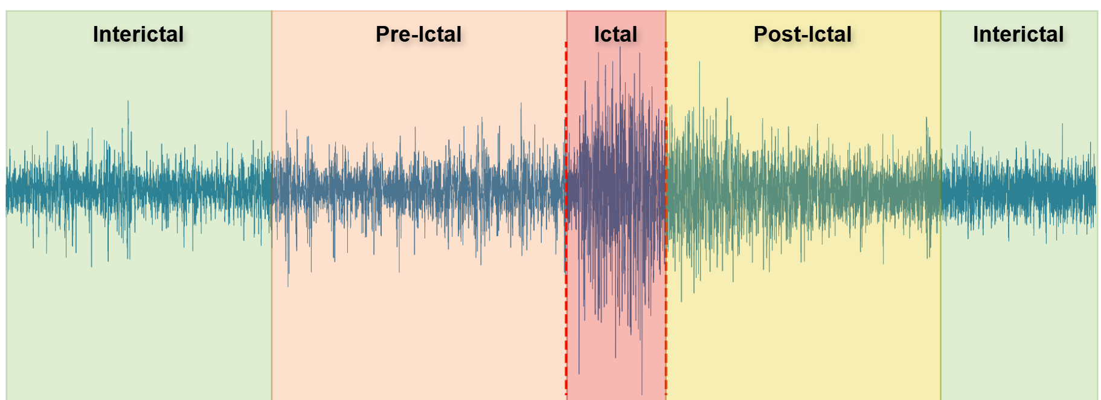
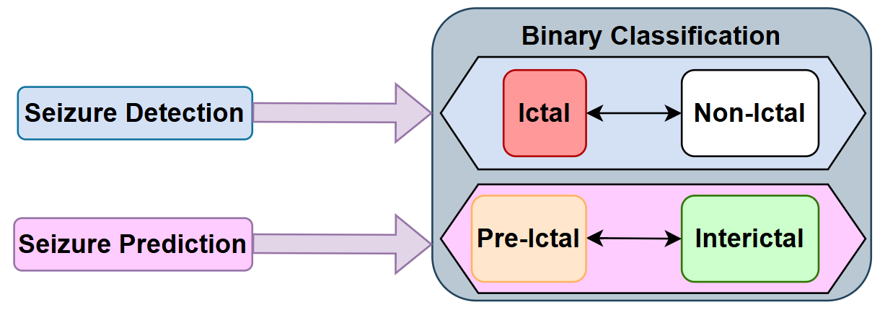
Epileptic Seizure Prediction
Most Prediction Works:
Big Models -> High Memory Requirements, Slow Inference
Many Channels(~23) -> Not Compatable for Wearable Devices
Solution:
Explore Compact & Energy-Efficient Model with reduced Channels
Suitable for Wearable, Low Energy, fast Inference

Slide 4
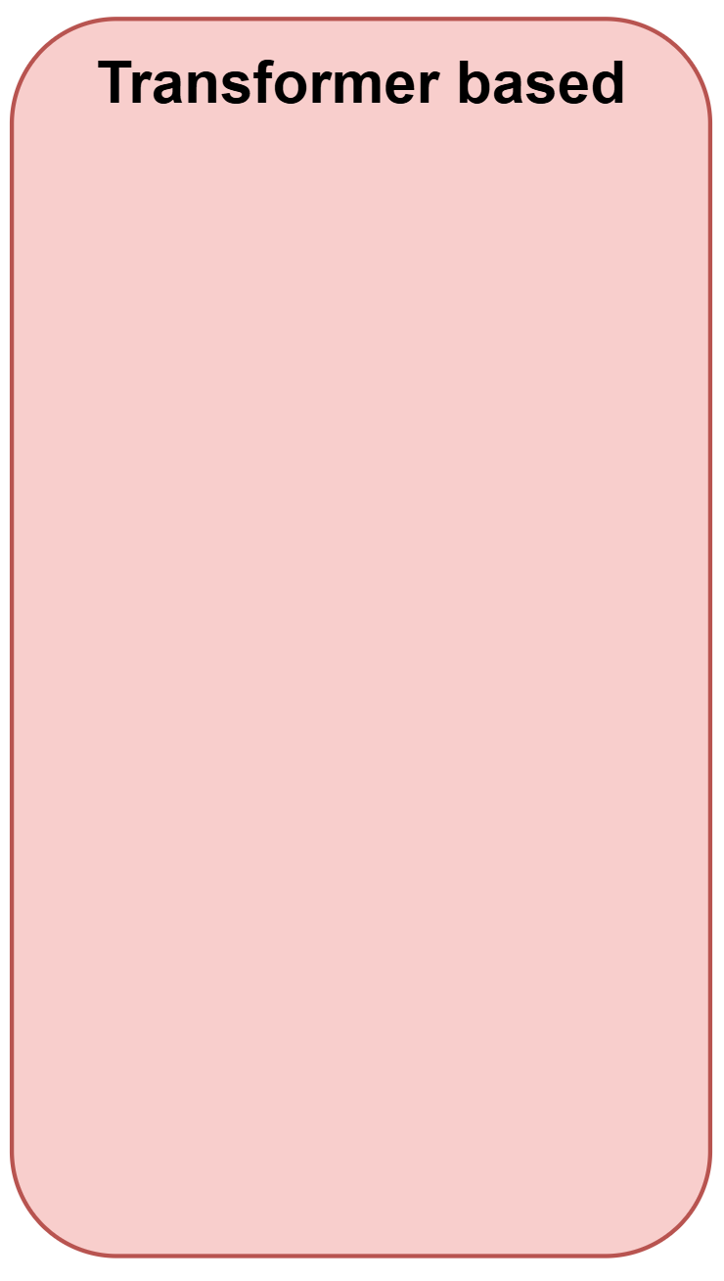
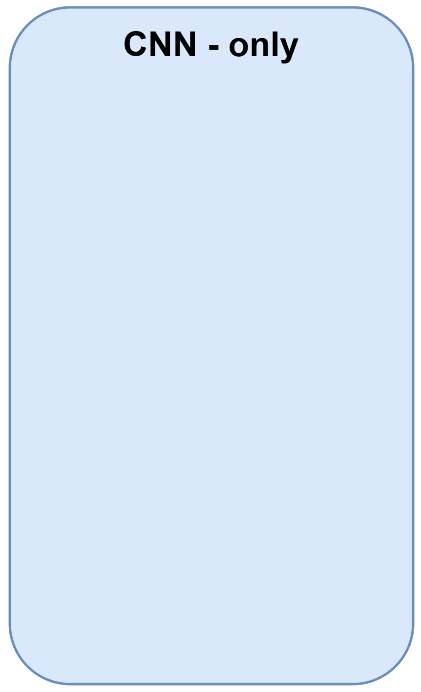
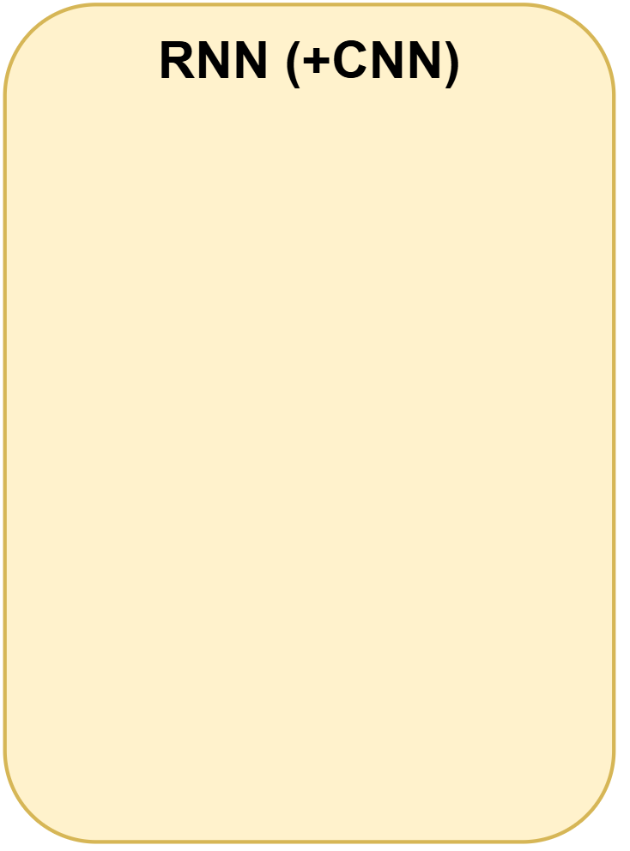
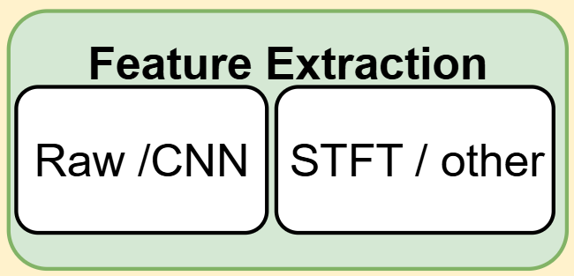
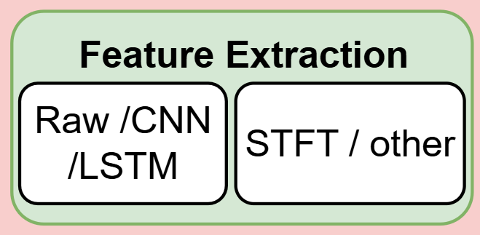
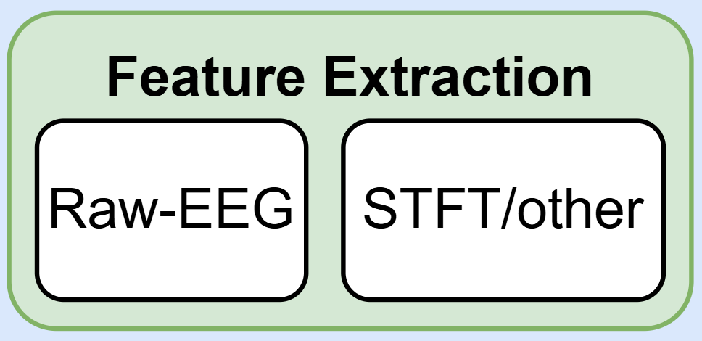
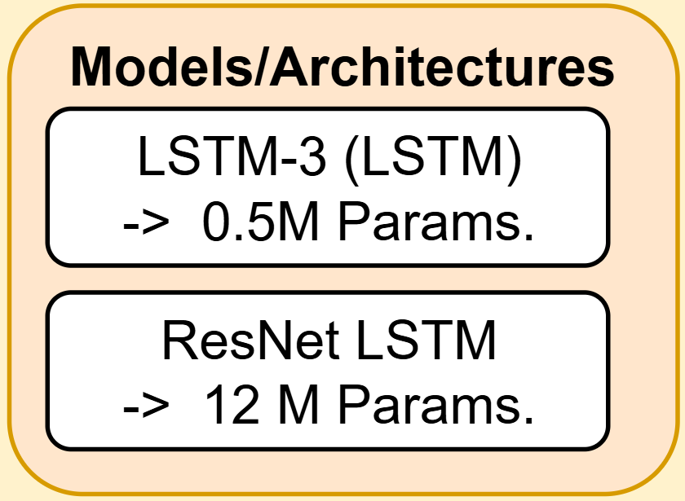
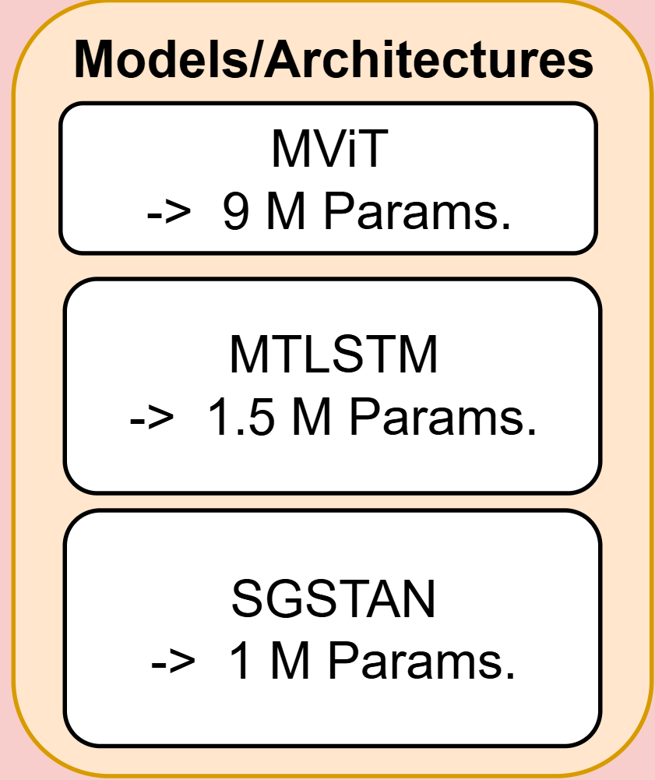
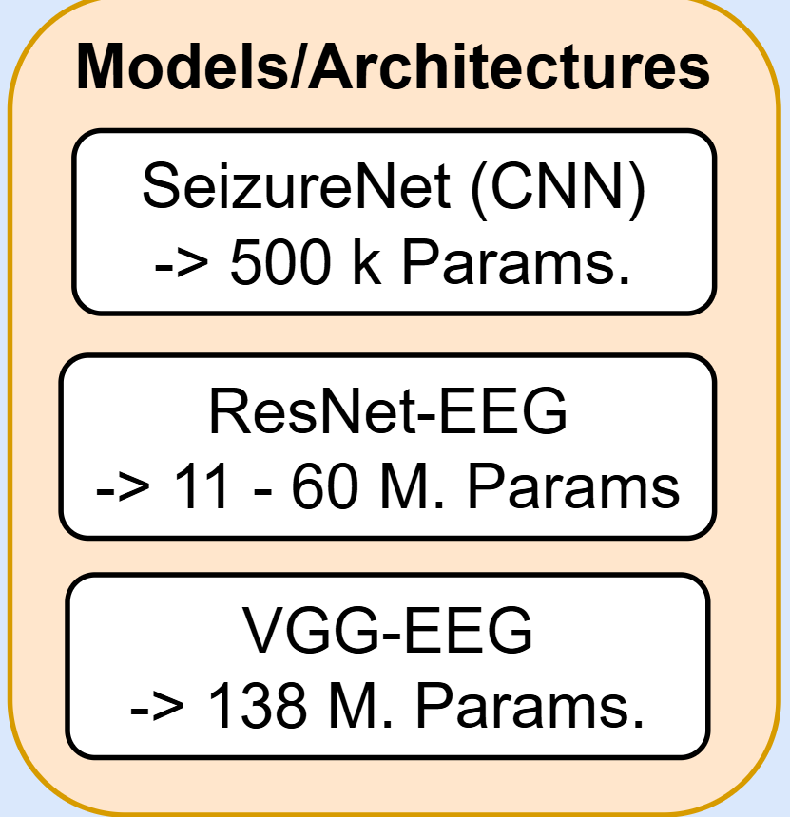
SoA Models: Seizure Prediciton
[lstm]
[CNN+LSTM]
[CNN]
[ResN]
[VGG]
[2]
[1]
[3]

Slide 5
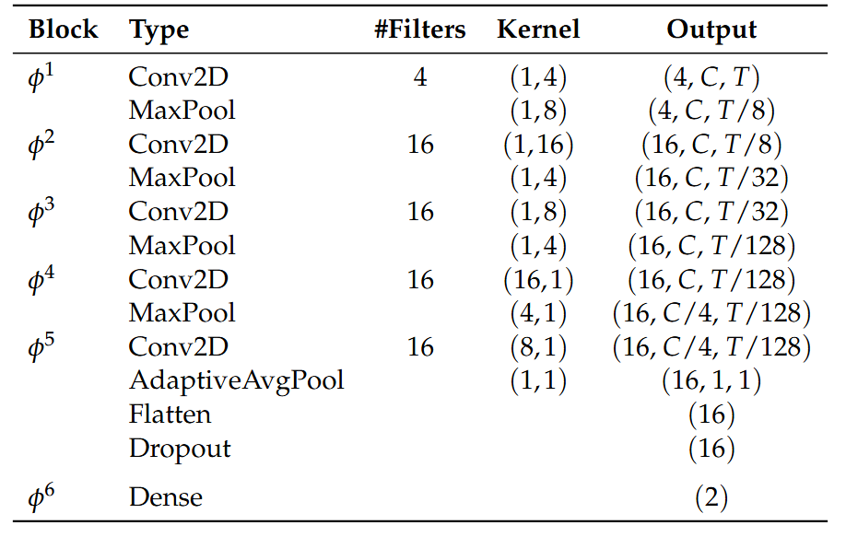

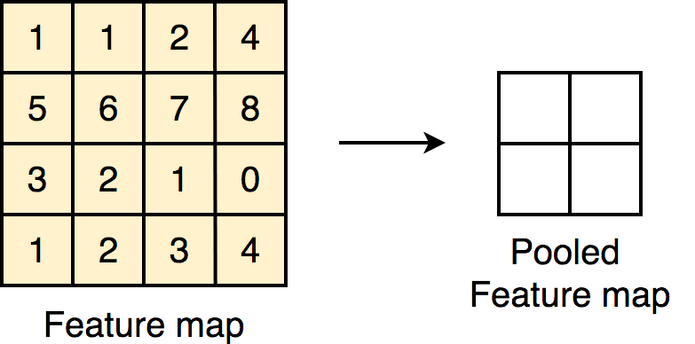
EpiDeNet for Seizure Prediciton
Convolutional Neural Network(CNN)
Learns Spectral & Spatial Features[3]
Leave-One-Seizure-Out CV
2 Classes (0:Interictal, 1:Preictal)
~ 9k Parameters
[3] Thorir Mar Ingolfsson, Upasana Chakraborty, Xiaying Wang, Sandor Beniczky, Pauline Ducouret, Simone Benatti, Philippe Ryvlin, Andrea Cossettini, Luca Benini: EpiDeNet: An Energy-Efficient Approach to Seizure Detection for Embedded Systems

Slide 6
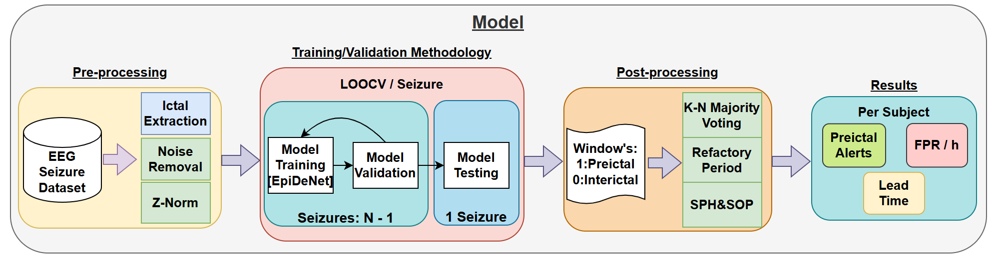
Model

Slide 7






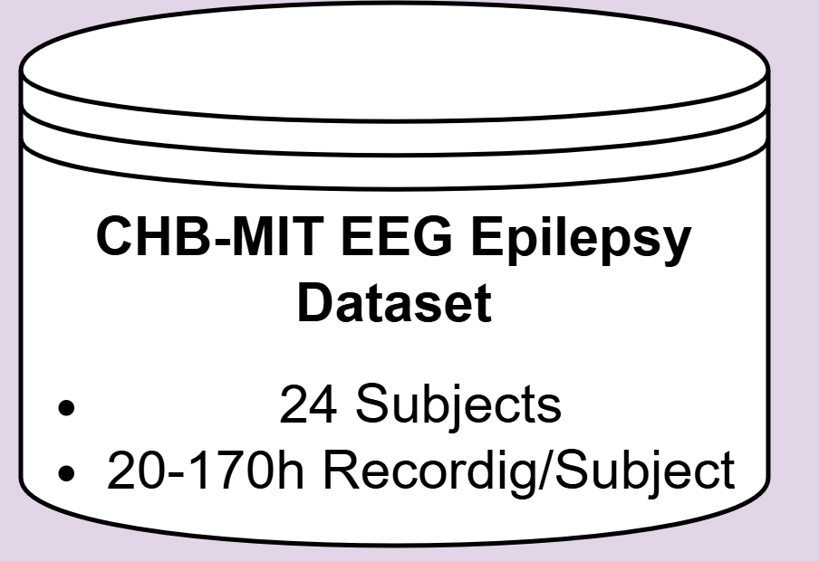
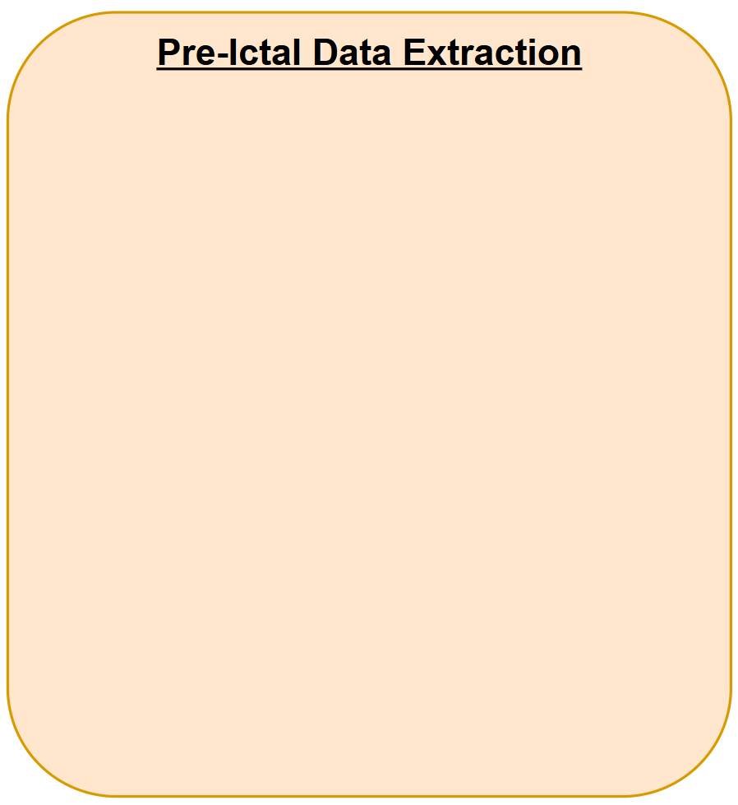
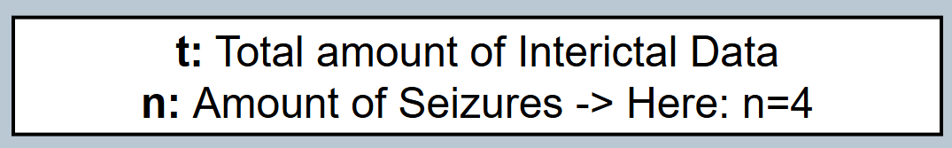
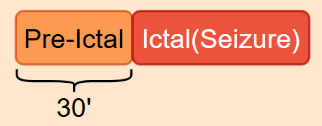
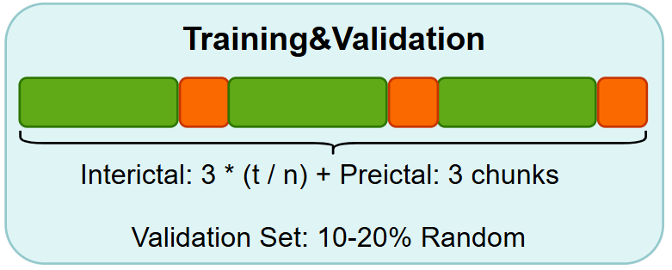
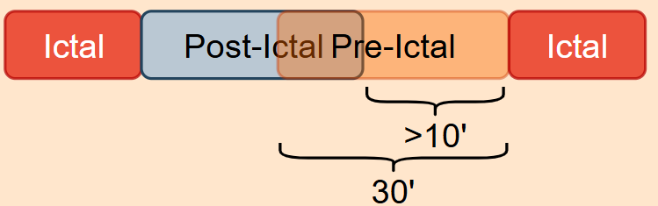
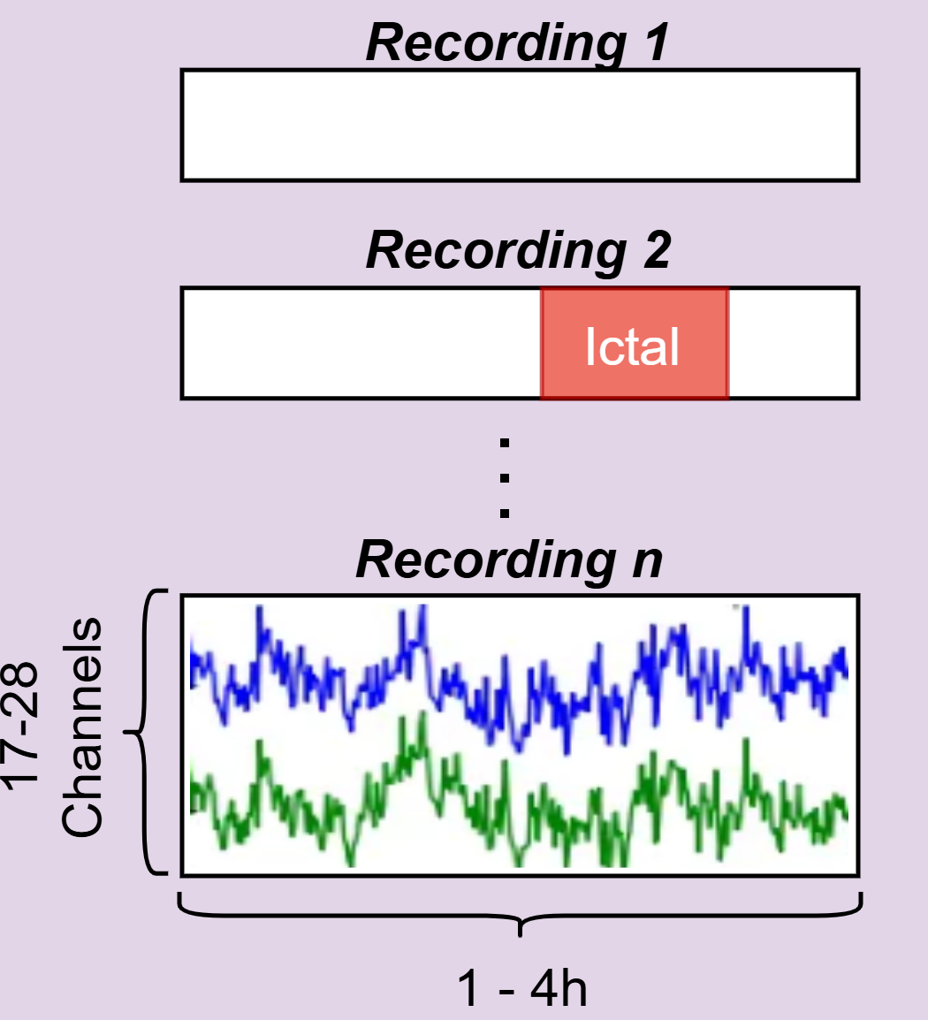
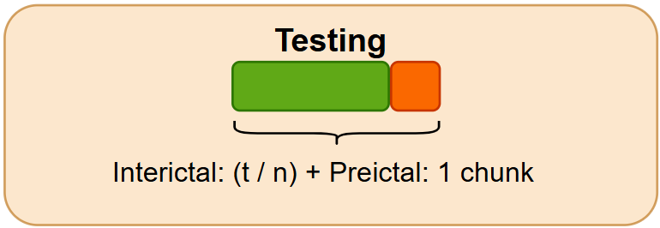
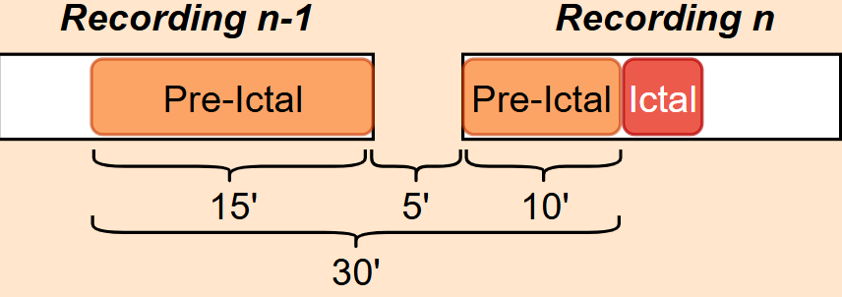

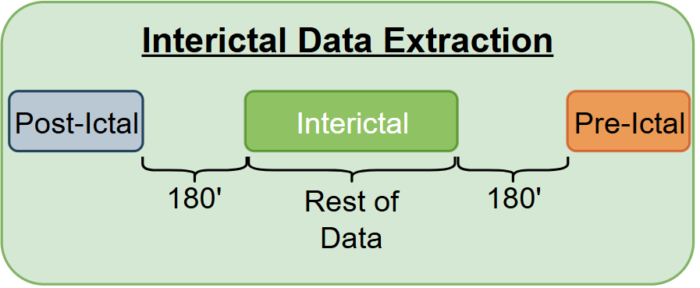
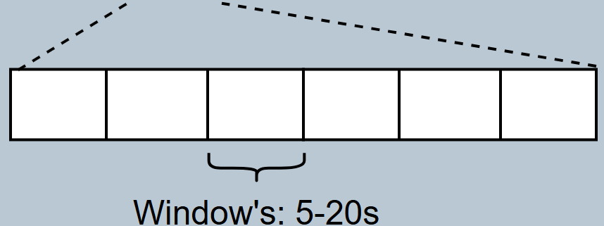
Data Handling (Per Subject)

Slide 8
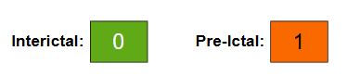
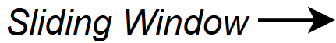





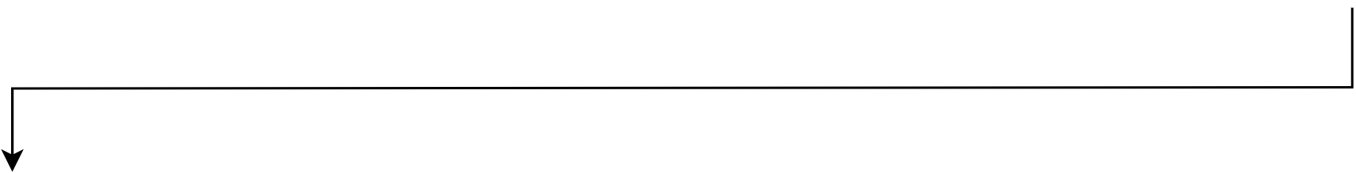




Post Processing
From Window -> Seizure Events
Turn Per-Window Scores into Per-Seizure Alarms (Preictal Alarms & FPR/h)
Summary:
Alarm < SPH
Alarm within SOP
Seizure Predicted Correctely

Slide 9
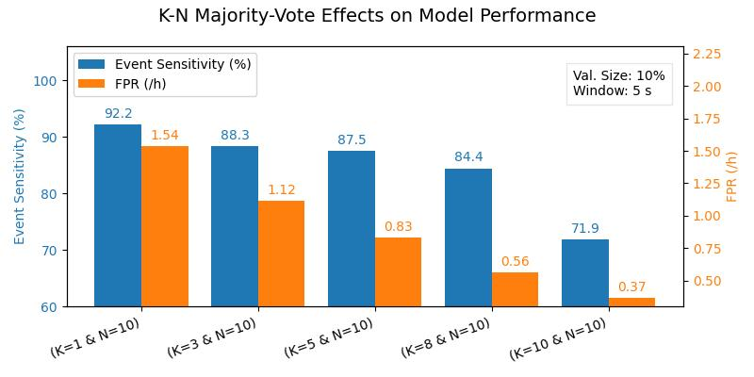
Post-Processing (K-N) Trade-Off : Event Sensitivity vs FPR/h

Slide 10
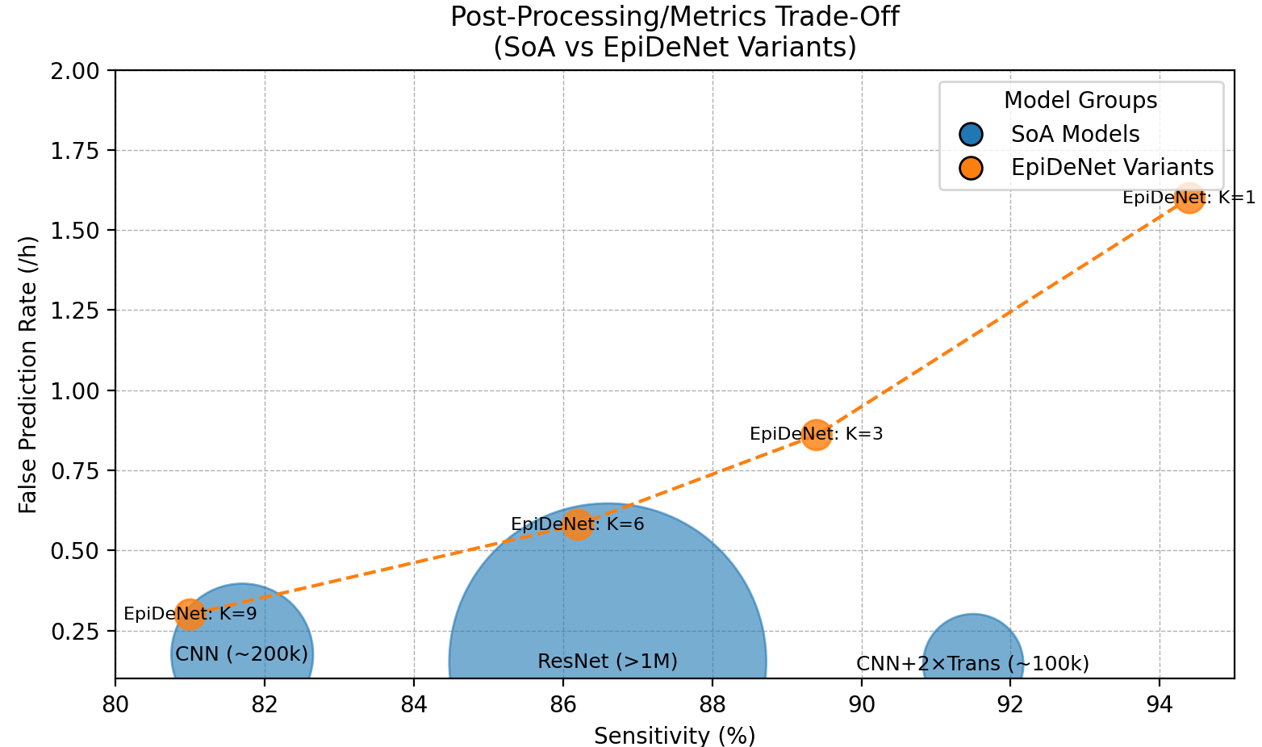
Results: Comparison with SoA

Slide 11
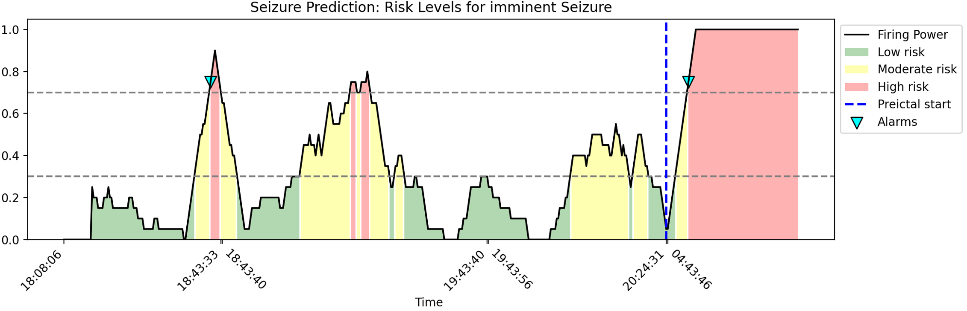
From Alarms to Risk Levels
Alarm: Discrete alert raised once high‐risk persists for K of the last N windows
Risk Level: smoothed probability of an oncoming seizure (Last N Windows)
Thresholds: T₁ = 0.3 (low→moderate), T₂ = 0.7 (moderate→high)

Slide 12
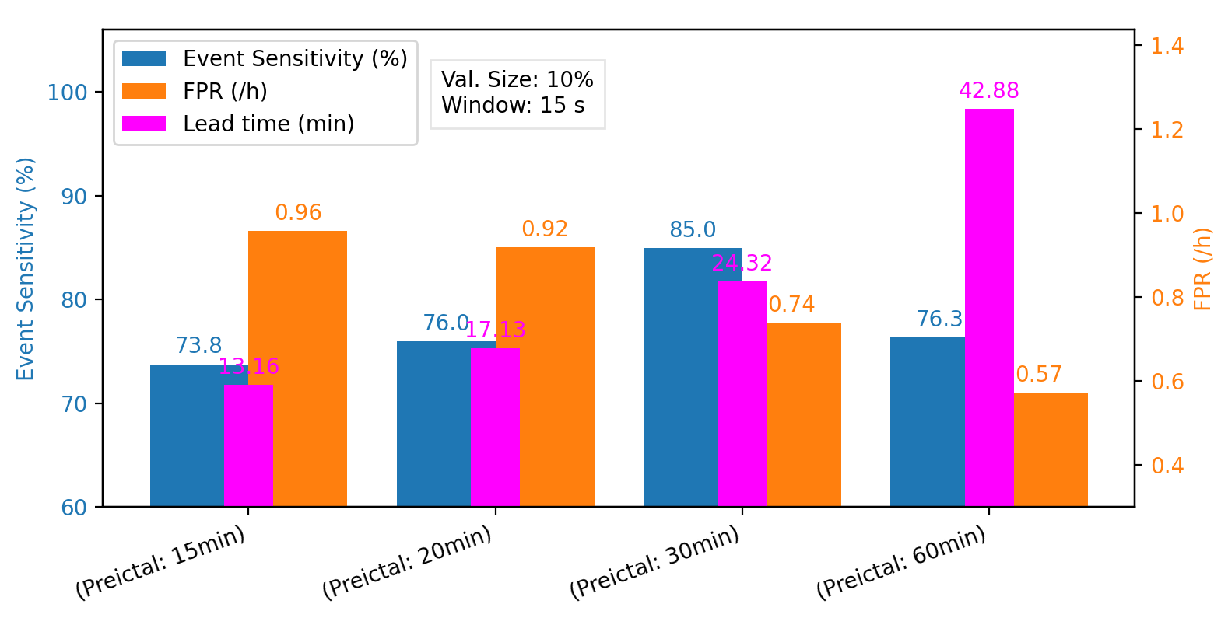
Trade‐Off: Pre‐Ictal vs. Prediction Performance

Slide 13
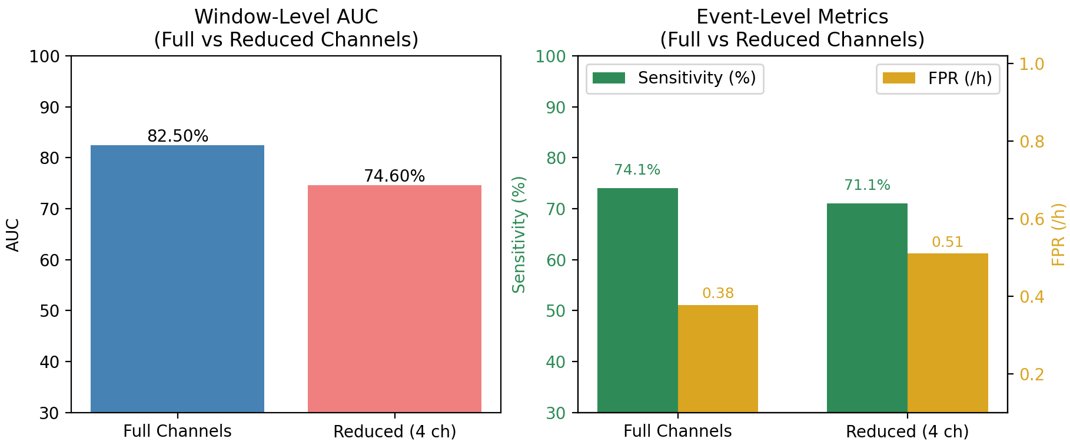
Channel Reduction Effects
4-Channel Setup :Lost 3% Sens & FPR increased by ~30% -> using 6× less Data
Channels used: ['FP1-F7', 'F7-T7', 'FP2-F8', 'F8-T8’]

Slide 14
Conclusion & Future Work
Reduced #Parameters & Model Size Significantly
Comparable slightly worse, Params better by 10-100x)
Model that can Raise an Alarm or/and give Risk Level
Multimodal & Feature Engineering:
Sensor Fusion: Use EEG in combination with ECG/PPG, accelerometry, etc. Combine Forecasting & Prediction (Risk Levels & Alarms)
Work on Model Architecture & Subject Specific Tuning
Pipeline Integration: Build continuous stream & alert framework and deliver to remote Device / IoT

Slide 17
Backup Slides
Model Metrics as Table
Model Performance (Loss curve etc)
Maybe: confusion matrix
Maybe: Other model

Slide 18
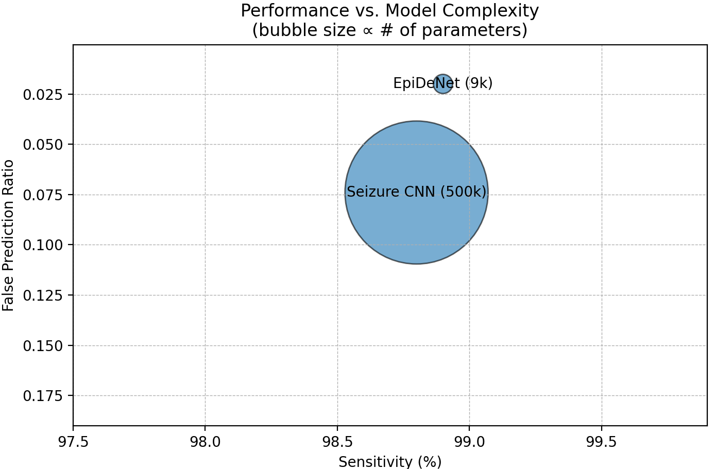
Results Model 1
Not Rigorous:
Same Seizures in Train & Test
Per Window Predictions

Slide 19
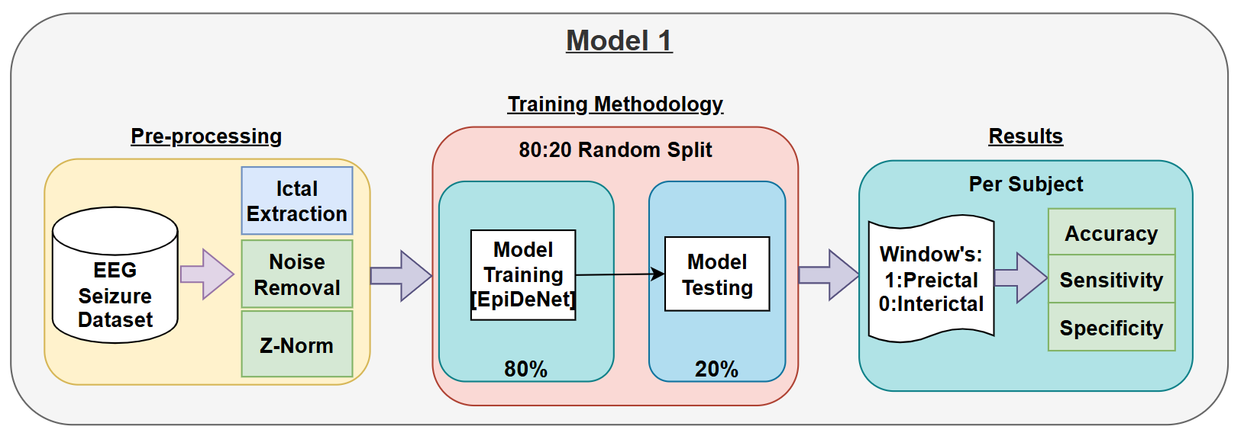
Lead Seizure Model -> Only Windows

Slide 20
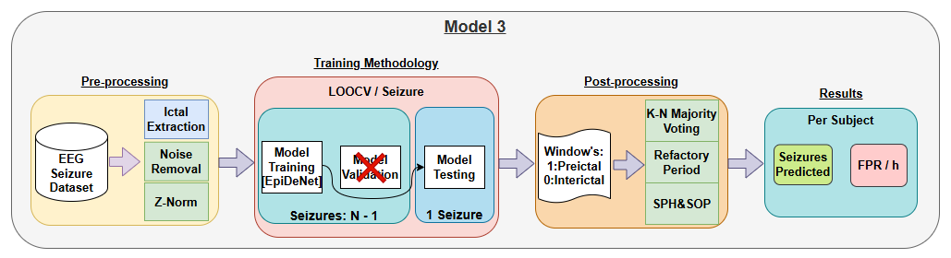
Model without Validation

Slide 21




Results Model 2
CNN
Preprocess: STFT
#Param: ~200k
Win Size: 30s
Validation: Validation: Last 25 %
ResNet
Preprocess: STFT
#Param: >1M
Win Size: 30s
Validation: Validation: Last 25 %
CNN + 2 Transformer
Preprocess: STFT
#Param: ~60k
Win Size: 30s
Validation: Last 25 %
EpiDeNet + Dropout
Preprocess: (Normalization)
#Param: ~9k
Win Size: 20s
Validation: Random 15 %
Without pt 19: Sn = 83%

Slide 22




















SSWCE: a=0.5 b=1.0

Slide 23






Limitations and Solutions
Interictal vs Preictal ratio up to 50:1
Risk of over-fitting to the negative class
Preictal signature varies between seizures
Different Seizure Types per Patient
Some patients show no clear preictal pattern
Interictal & preictal look alike

Slide 24


